Slide 1
St1504: Deep LEarning ca1 Part A (Convolutional Neural Network)
Done by: Lee Hong Yi, p2223010
(DAAA/FT/2B/07)

Slide 2
Introduction to task
Objective: To build image classifiers using deep learning networks for 15 types of vegetables. Two different input sizes (31x31 pixels and 128x128 pixels) will be considered, and the images will be converted to grayscale (1 channel) for both input sizes. The classification accuracies of the two models will be compared and discussed.
Background Information: In this task, we will focus on developing image classifiers for a dataset containing 15 types of vegetables. The goal is to accurately classify the vegetables based on grayscale images with two different input sizes: 31x31 pixels and 128x128 pixels. By comparing the performance of models trained with these different input sizes, we can gain insights into the impact of image resolution on classification accuracy. This assignment's constraints are done to represent any difficulties that are possible in real-life data gathering, such as in the medical field.
Output Variable: The main output variable of this task is the classification accuracy of the two models for each input size (31x31 and 128x128 pixels). Additionally, the task aims to provide insights and a discussion on the performance differences between the two models and their suitability for the given image classification problem.

Slide 3
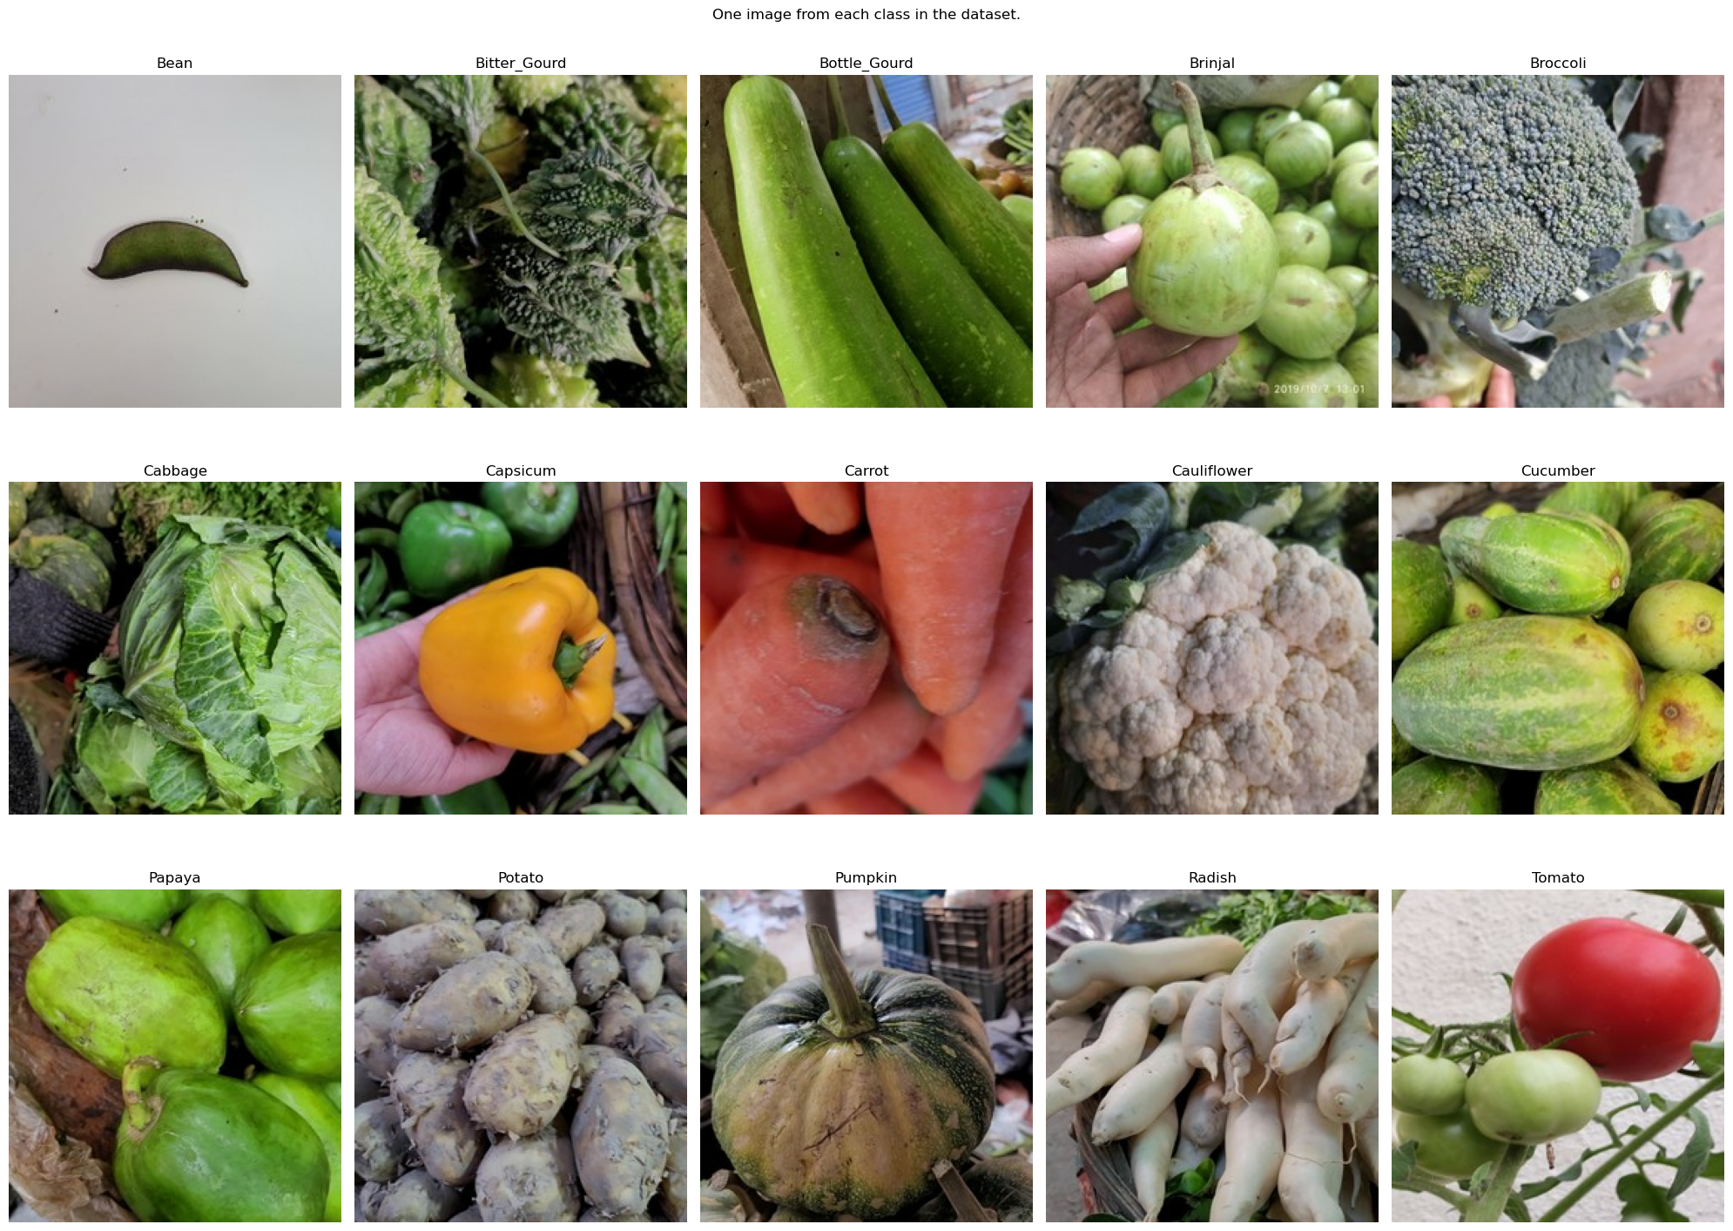
Loading Data + EDA
Since the data has already been collected and given to us, we can import it straight away into Python.
Looking at a random image from each class, we can see that the images are very varied. Most of them are top-down, with some having other vegetables in the background.

Slide 4
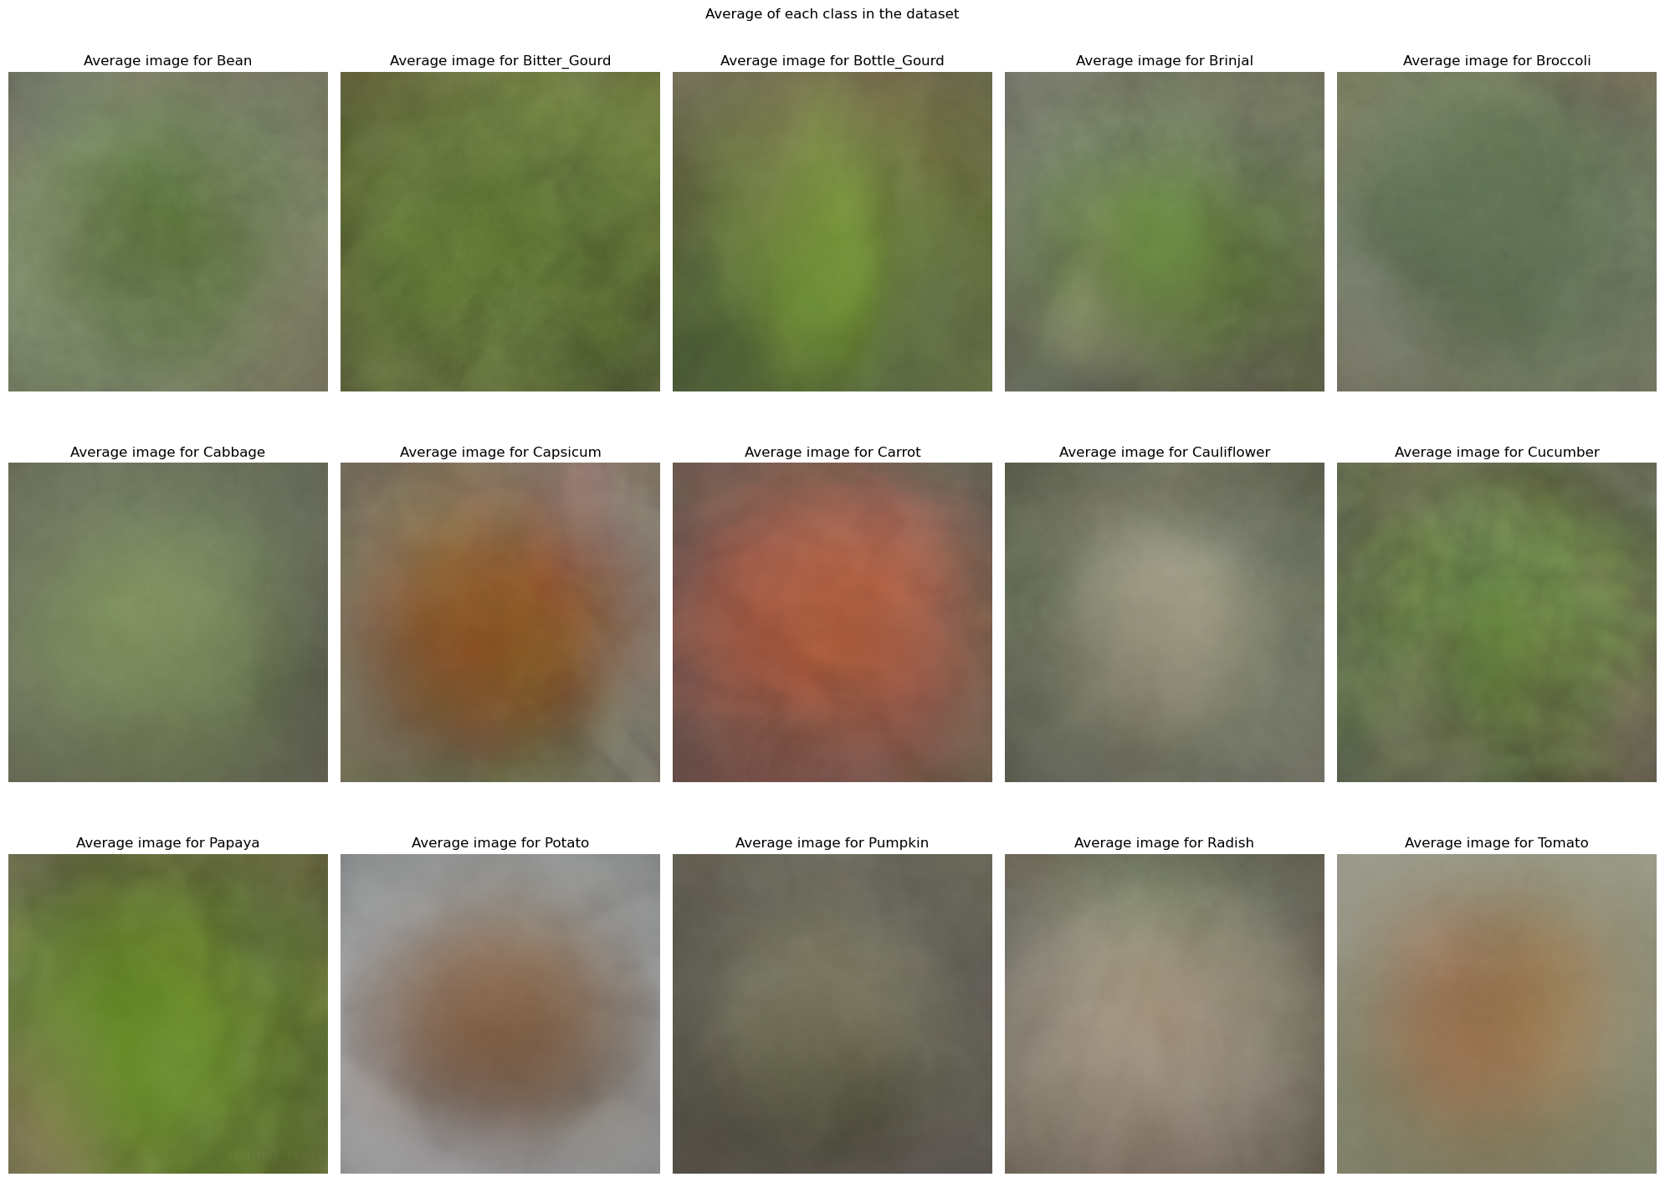
EDA
When we break down the average image of each vegetable, we can see that there are 3 distinct colours in the dataset, with Capsicums, Carrots, Potatoes, and Tomatoes having high red values, while Cauliflowers, Pumpkins, and Radishes being whiter, meaning that they are higher in all colour channels. The rest of the vegetables have greener average images, showing that they have a higher load in the green colour channel.

Slide 5
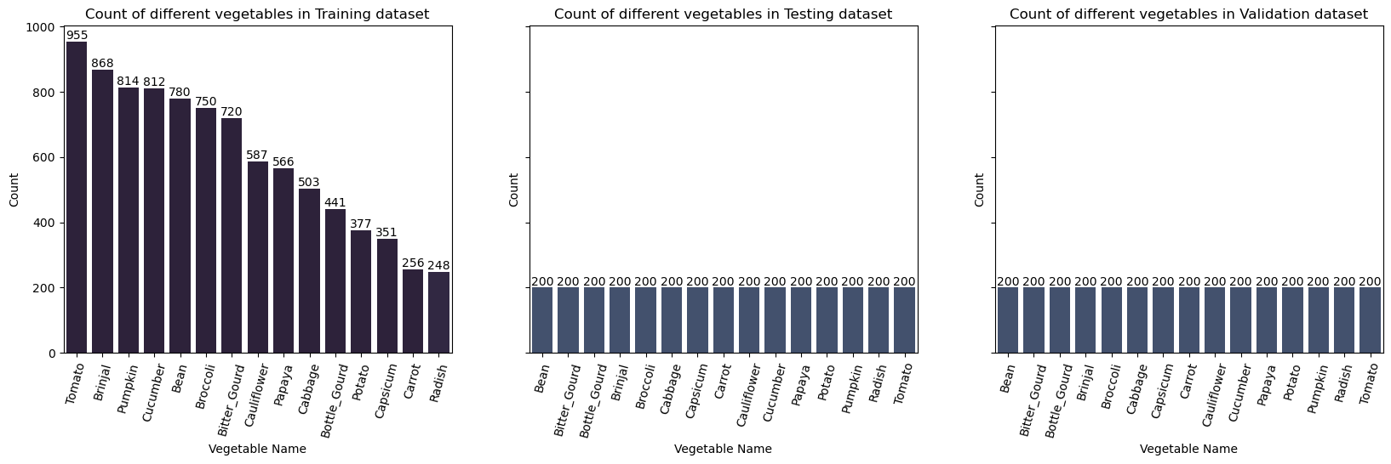
EDA
From the EDA, we can also tell that there is a severe class imbalance in the training dataset, with Tomatoes being the most prevalent in the dataset, with 955 samples, while classes like Carrot and Radish are under-represented, having 256 and 248 samples respectively.
However, there is no imbalance in the Testing and the Validation datasets, with all classes having 200 samples.

Slide 6
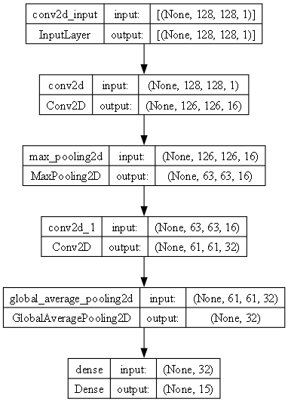
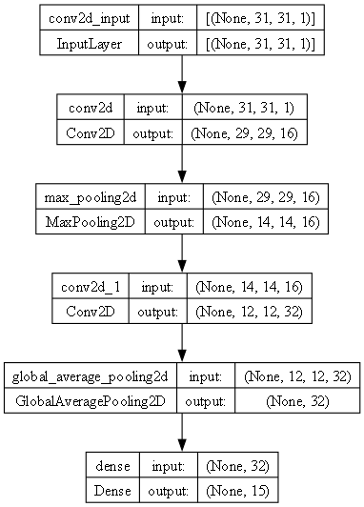
Baseline models + data prep
To help us identify the best data preparation pipeline, we shall establish a baseline model, then test it out on the different steps, to see which steps are the right ones to take to improve the accuracy of the model.
As a baseline model, we shall use a simple convolutional neural network, using tensorflow's Conv2D layers. These are better suited for image classification tasks due to their ability to work on local regions of the image, allowing it to detect features such as edges and patterns. This allows it to understand the structure and content of an image better than other types of models.
In addition, we shall use Sparse Categorical Crossentropy over other types of entropy loss functions, as it is better suited to the nature of our dataset. Sparse Categorical Crossentropy is useful when handling a larger amount of classes, like our use case here. If we were to one-hot encode the labels, like is needed for Categorical Crossentropy, we would have generated larger, sparser matrices, which are inefficent when it comes to memory usage.

Slide 7
Baseline models + data prep
We downsize the image to the target sizes of 31 x 31, as well as 128 x 128 first. After that, we test different grey scaling methods using the baseline model, namely, the Luminosity, Desaturation methods, along with the normal grayscaling method.
From our results, we can see that at both resolutions, the Luminosity method yields the best accuracy, and the second-best loss. Hence, we shall continue using it for the rest of the task.
We can also note that the resolutions yield a negligible difference, showing that our models may currently be too simple to take advantage of the extra data in the 128 x 128 images.
Hence, we finalize the data by grayscaling them using the Luminosity method, and then standardizing it.

Slide 8
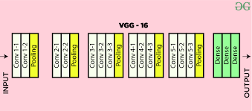
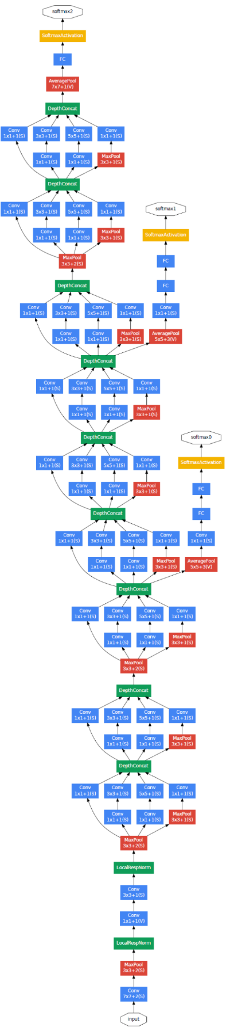
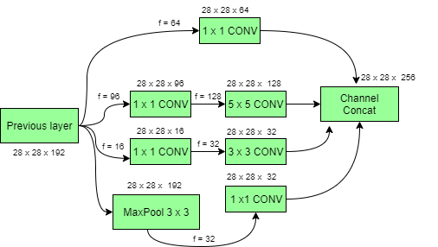
Initial modelling
Given that we already started using a basic CNN as a baseline model earlier, we shall now move onto using more complicated models for our task. We shall base our more complicated models off of the already established VGG and InceptionNet architectures, modifying them slightly to fit our use cases.
For both models, we simplify them accordingly, tuning them to fit our input sizes of 31 x 31 and 128 x 128 when needed.

Slide 9
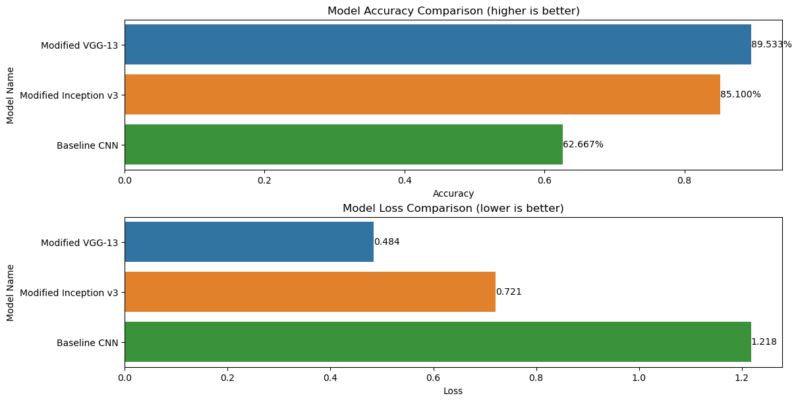
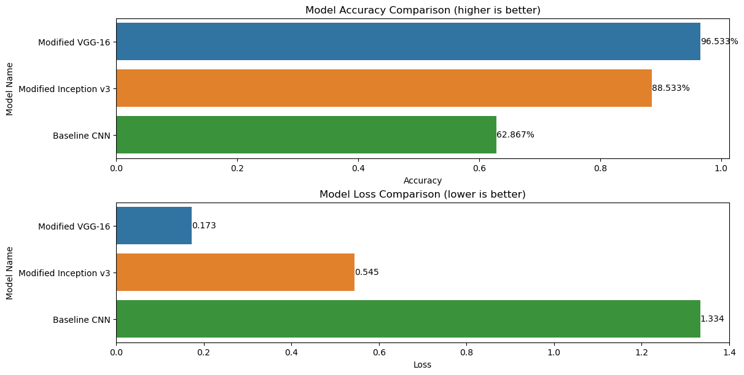
Initial modelling
For the 31 x 31 resolution, we can see that the VGG architecture performs the best, hitting an accuracy of 89%, beating out InceptionNet, and massively outperforming our baseline CNN (62%).
For the 128 x 128 resolution, we can see that the VGG architecture is still the best performer, (92% acc.), which is leaps and bounds better than InceptionNet (88%), and our baseline CNN (62%).

Slide 10
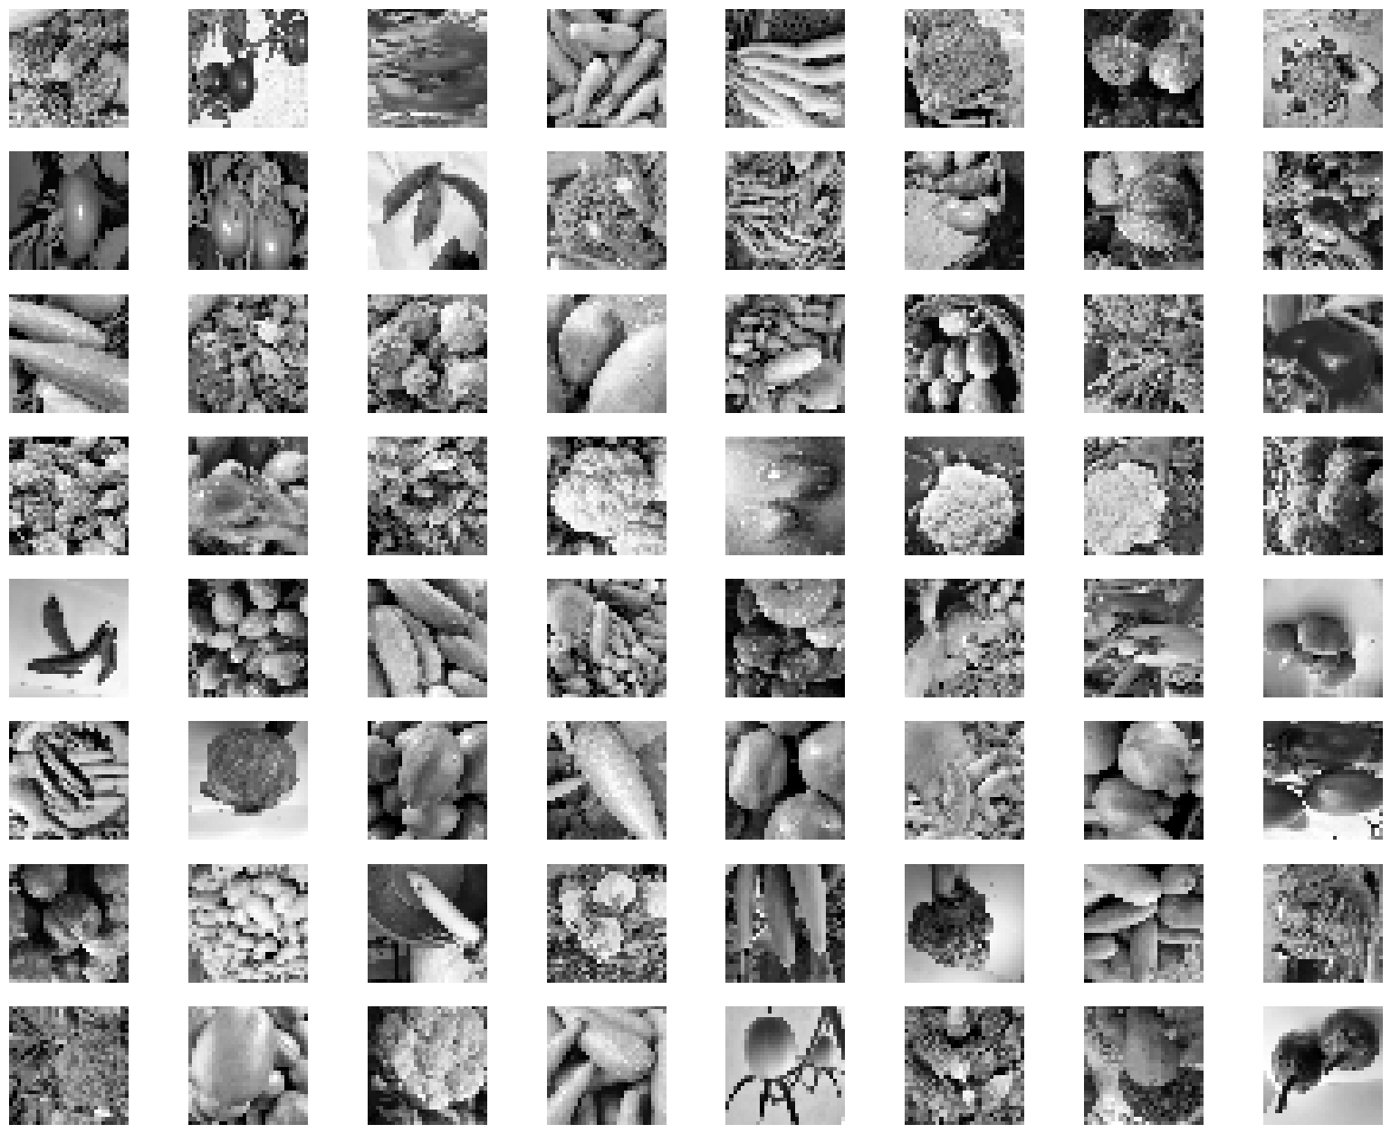
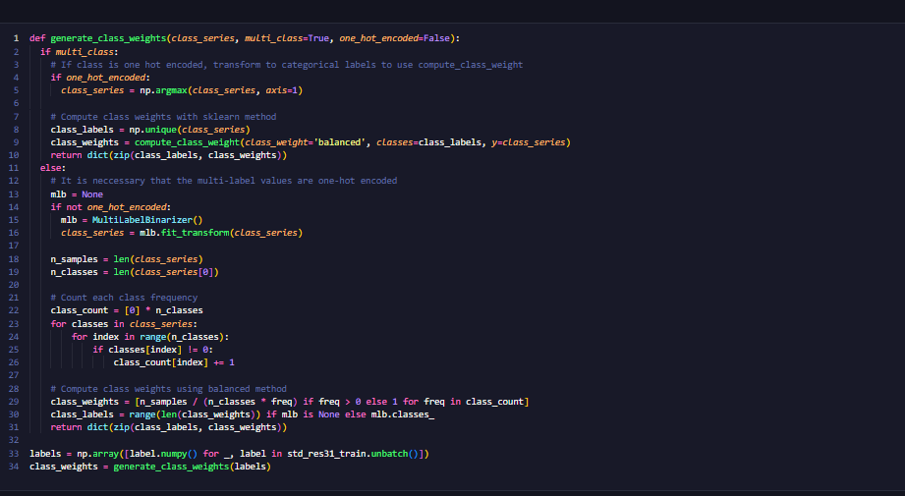
Model improvement
Now that we have identified the best model architecture, we shall now try to improve it by applying techniques such as Augmentation and Class Weights.
For Augmentation, we flip our pictures horizontally, zoom in on them further, and perform 90-degree rotations at random, allowing for more variations in the training data.
For Class Weights, we create a function to calculate the weights that should be assigned to each class, then apply them to our model.

Slide 11
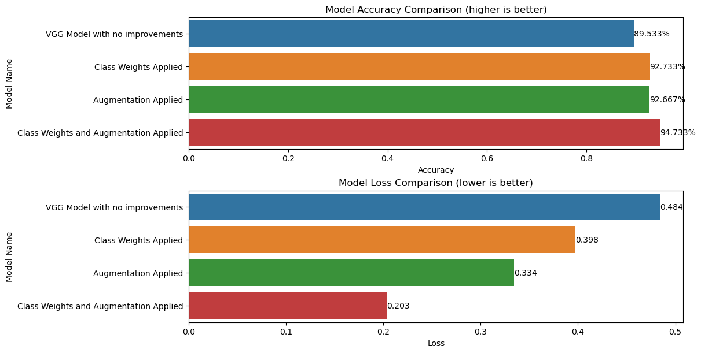
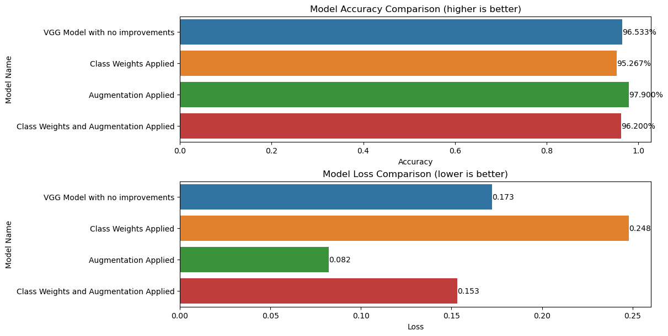
Model improvement
We test the effectiveness of our techniques by re-training the models, applying one technique at a time, then combining both.
For 31 x 31 images, we can see that the largest improvement is made when both techniques are applied. We shall select this combination for hypertuning.
For 128 x 128 images, we can see that the largest improvement is made when only augmentation is applied. We shall select this combination for hypertuning.
In addition, we can also see the effects of Image Augmentation, and how it improves the performance of the model(s).

Slide 12
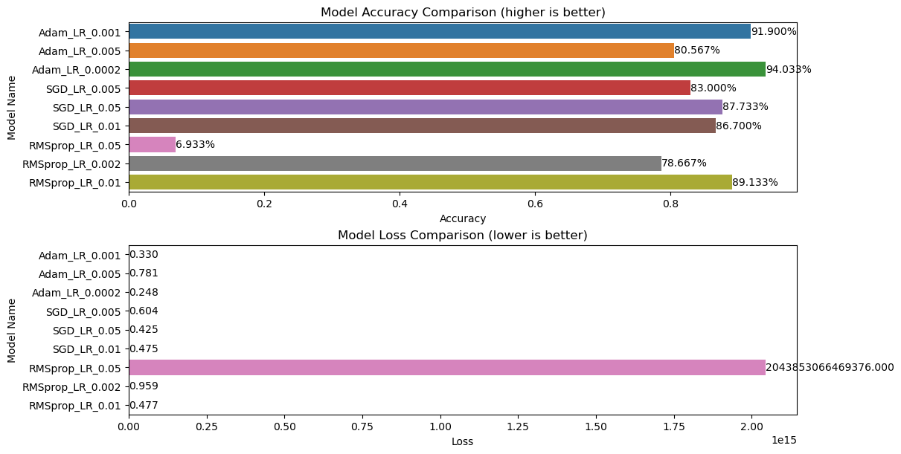
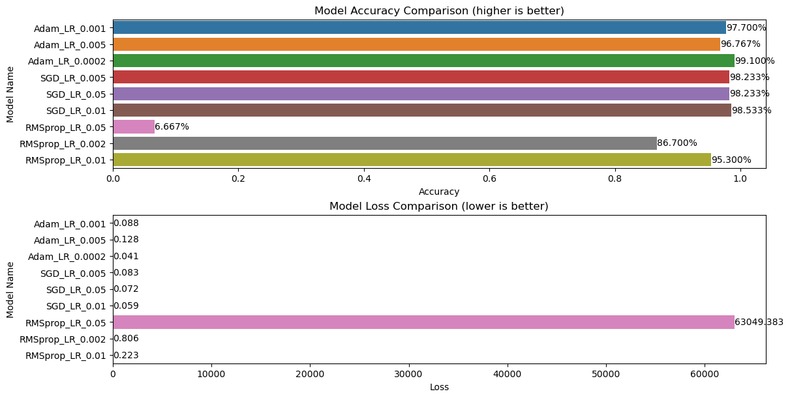
Hypertuning
Now, we attempt to further improve the model’s performance by attempting to hypertune the parameters of the model. For this case, we do so by changing the optimizer, and it’s parameters.
For both resolutions, we can see that the Adam optimizer with a learning rate of 0.0002 gives the best performance.
Now, we allow both models to train for another 50 epochs, in order to ensure that as much training is done before we draw our final conclusions.

Slide 13
Conclusions
31 x 31 Image
Model: VGG-13
128 x 128 Image
Model: VGG-16
Acc.:
94.63%
Loss:
0.2317
Acc.:
99.03%
Loss:
0.0439
To conclude, this exercise has allowed me to learn alot more about the field of deep learning, and the considerations that have to be made when attempting to craft a tool for a task. One part where I understand better are the limitations placed on us, especially regarding the greyscaling and resolution constraints.

